Slide 1

Quantum Federated Learning
Presented by Trong-Binh Nguyen-202388548 Pusan National University
November 21th, 2023

Slide 2
Table of contents
Federated Learning
Introduction
Architecture
Optimization
Quantum Machine learning
Overview
Quantum NN
Quantum Gradient
Quantum Federated Learning
Vanilla QFL
Slimmable QFL
QFL-Deep Unfolding Network
Simulation
Github Code

Slide 3
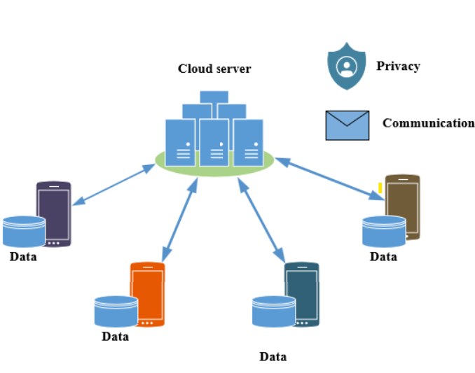
1. Federated Learning: Introduction
Data Explosion:
The growth of IoT devices
Deep insights of data distribution
Privacy of users and performance
Federated Learning:
Decentralized Learning technique
Provides privacy and good performance
Challenges:
Large dataset and complex model
Privacy and security

Slide 4
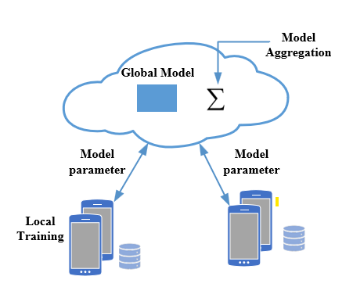
1. Federated Learning: Architecture
Server:
Global model initialization
Receive client model parameters update
Performing optimization based on parameters
Sending back parameters to clients
Clients:
Received global model parameters
Training based on the local client dataset
Sending model update to the server
Model Architecture:
Server and client share the same model architecture but different parameters
Note:
Only parameters communicated

Slide 5
1. Federated Learning: Optimization
Global Server Optimization:
Model Averaging
Gradient Conflict Reduction
Data-free Global Learning
Local Clients Optimization:
Clients Personalization
Domain Generalization
→ Enhanced the performance and generalization of local model and global model
A. Fallah, A. Mokhtari, and A. Ozdaglar, “Personalized federated learning with theoretical guarantees: A model-agnostic meta-learning approach,” in Advances in Neural Information Processing Systems 2020
A. T. Nguyen, P. Torr, and S.-N. Lim, FedSR: A simple and effective domain generalization method for federated learning,” in Advances in Neural Information Processing Systems,

Slide 6
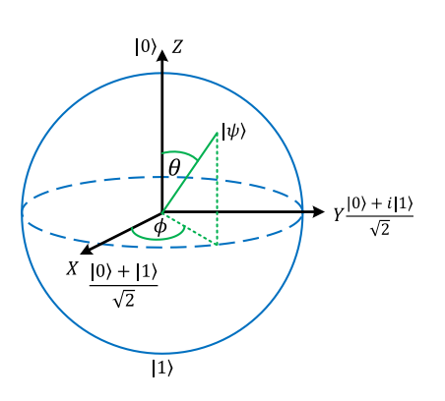



2. Quantum Machine Learning: Overview
Basic Quantum Gates:
Quantum state:
Classical data encoded to quantum state using rotation gates:
In the multiple qubit system, qubits can be entangled with controlled-NOT (CNOT) gates.
Block sphere

Slide 7
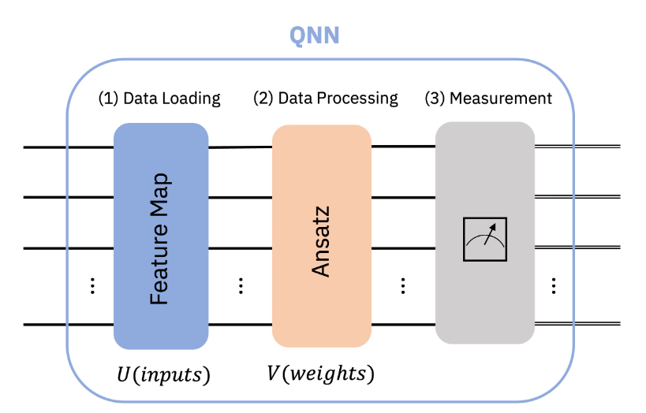


2. Quantum Machine Learning: QNN
Structure:
State Encoder
Parameterized Quantum Circuit
Measurement layer
Role:
Encoded classical input x with basic rotation gate
PQC: Multi-layered set of CNOT gates and rotation gates associated with trainable parameters
Measurement output as observable
Loss function:
Observable vs ground truth of input, loss is calculated
QNN is trained using SGD:
Gradient is calculated using the parameter shift rule

Slide 8

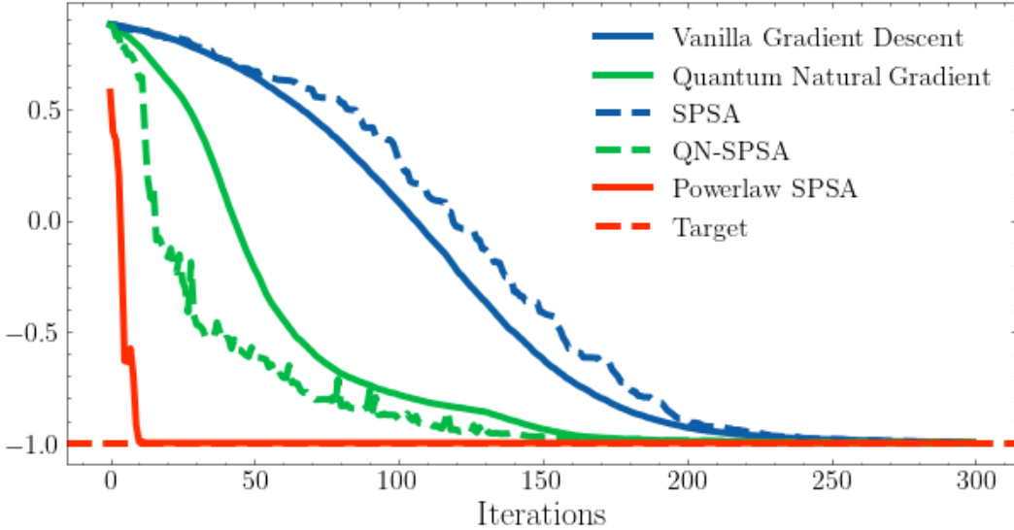
2. Quantum Machine Learning: Quantum Gradient descent
Quantum gradient descent:
When we train a parameterized quantum circuit model, the function to minimize is the expected value
https://github.com/zlaabsi/quantum_ml.git

Slide 9
3. Quantum Federated Learning: State of the art research
Vanilla quantum federated learning:
FedAvg algorithm
Procedure
Slimmable Quantum Federated Learning:
Local optimization
Better performance over worse channel condition
Toward QFL with Deep-Unfolding Network:
Global optimization
Code provided

Slide 10
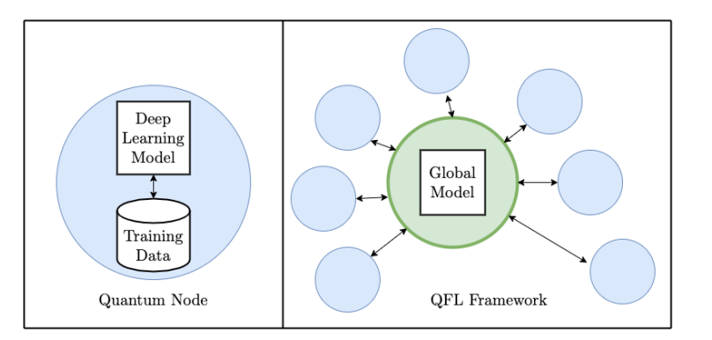


3. Quantum Federated Learning: Vanilla QFL
Procedure:
Follow the traditional FedAvg
Each device’s local training of an QNN
The global QNN parameter given by the averaged PQC angle parameter
→ General structure for all current Quantum Federated Learning framework

Slide 11
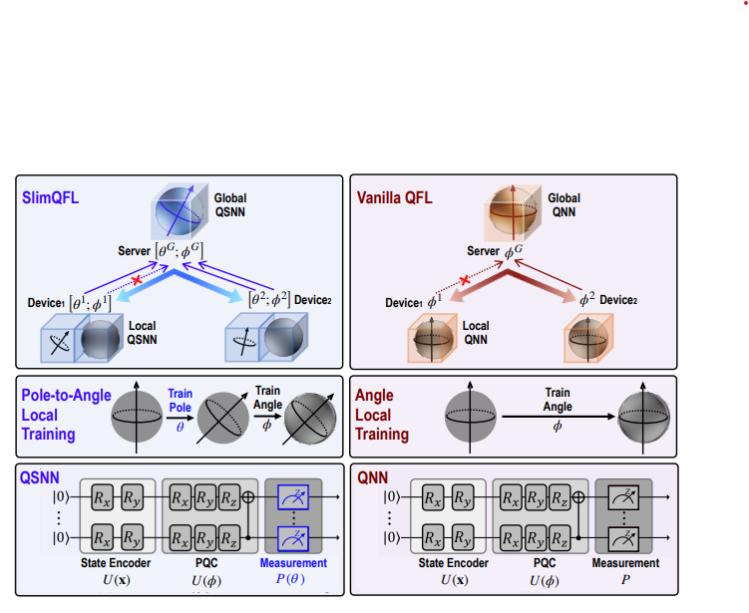

3. Quantum Federated Learning: Slimmable QFL
Proposed Idea:
View QNN as two sets of separately tunable parameters: angle parameters and pole parameters
SlimQFL trains the angle and pole parameters of QSNN separately in a sequential way
First train the pole parameters , then train the angle parameters
Each communication round, depending on channel condition, the device can upload: only pole parameters or both pole and angle parameters.

Slide 12
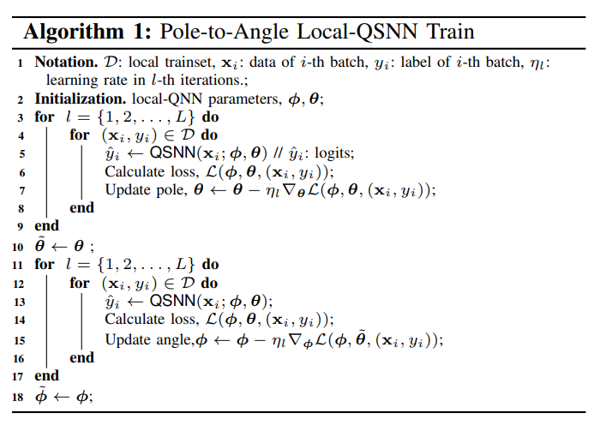
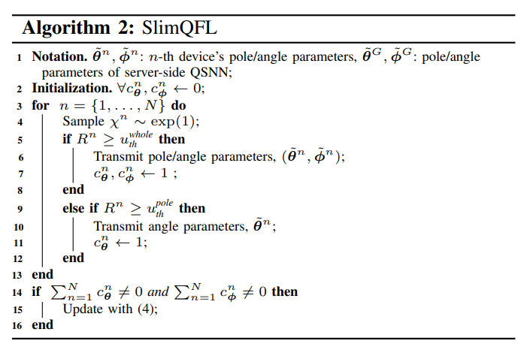
3. Quantum Federated Learning: Slimmable QFL

Slide 13
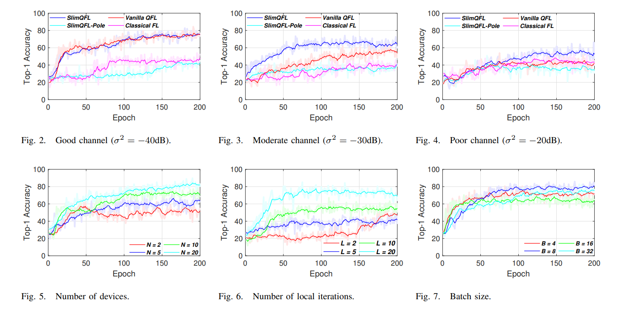
3. Quantum Federated Learning: Slimmable QFL

Slide 14





3. Quantum Federated Learning: QFL-Deep Unfolding Network
Global optimization:
Problem of non IID data and devices.
Instead of traditional averaging, proposed weighting strategy, assign weight to local client parameters then average. This leads to overall effectiveness
DUNs involve exploiting and reformulating an iterative algorithm as a deep neural network
F() Denotes the function or operation applied to the state using parameters to obtain the update state
Deep unfolding can transform such an iterative algorithm into a deep neural network as

Slide 15
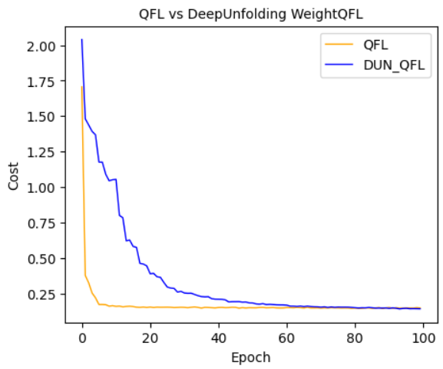
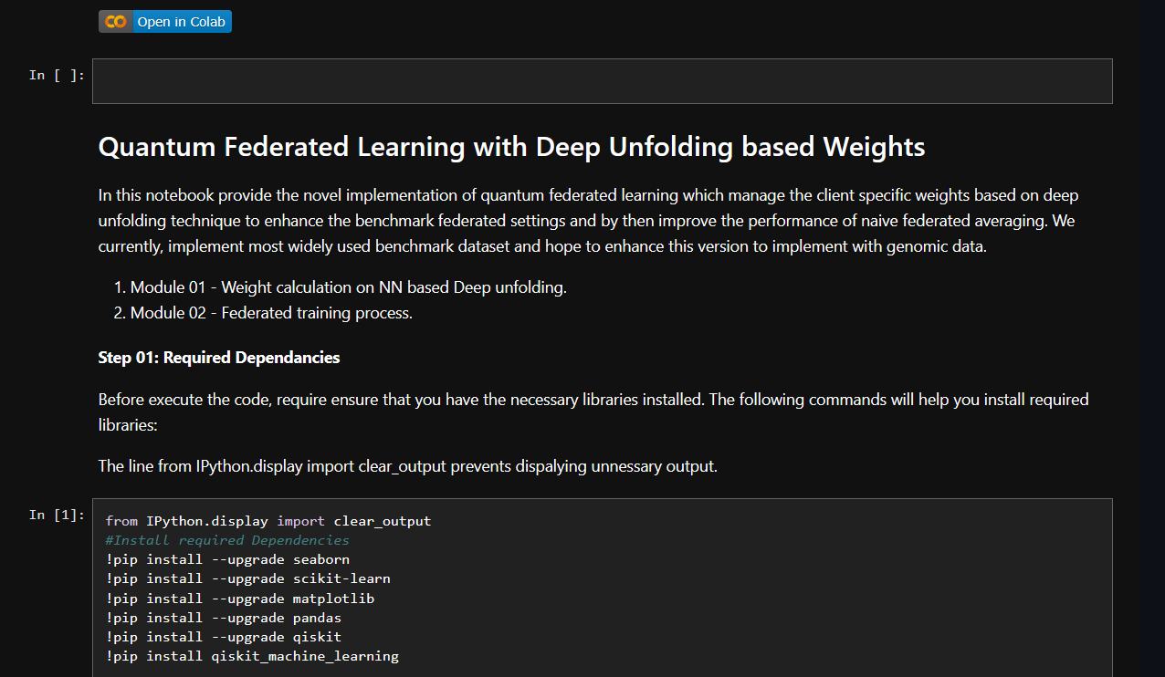
4. Simulation: QFL-Deep Unfolding Network Github
Quantum FL with deep Unfolding based weights:
https://github.com/shanikairoshi/QFL-with-DUN.git

Slide 16
Related Works
https://github.com/WhiteByeBye/Post-Quantum-Secure-Blockchained-Federated-Learning.git
https://github.com/s222416822/PQC-QFL-Model.git

